Slide 1
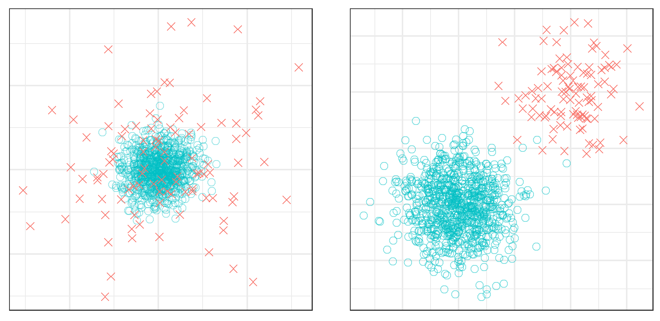

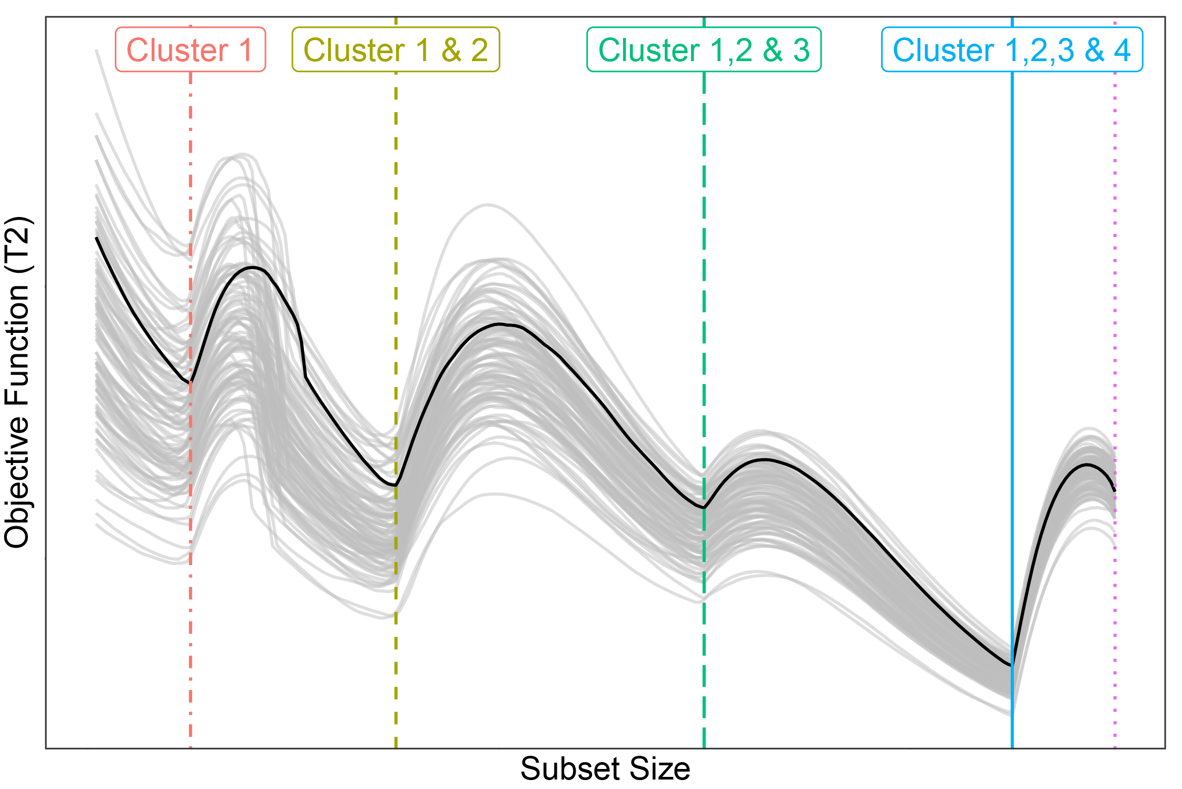

ATLA & the forward search; for robust outlier detection and clustering in multivariate data
Brenton R. Clarke & Andrew Grose
Problem
Solution
How exactly, do we define an outlier?
Different generating models
Comparing multivariate outlier detection procedures is difficult!
Apples to apples
More performance measures
Parametric tests are great but multiple testing is not!
Corrections?
Objective functions
What use is a statistical algorithm if it is stochastic?
Deterministic algorithms
Notes:
This poster (#1) is a synthesis of a research paper (#2) published with my honours supervisor, looking at comparisons of multivariate outlier detection procedures through simulation. (#3) First, how did we define an outlier? Answer: using different simulation models (#4), namely the Tukey-Huber and Mean Slippage models. (#5) To make life easier we focused solely (#6) on one class of methods across (#7) several performance measures. (#8) Some of these methods are good in that they assume a parametric distribution to test for outliers, (#9) only with corrections for multiple testing which can be bad. (#10) Alternatively, the adaptive trimmed likelihood algorithm (ATLA) uses an OBJECTIVE FUNCTION to divulge the structure of data. (#11) This method originally uses a fast algorithm to obtain a starting estimate however we adopt a “deterministic” algorithm which leads to improved performance. I made a a shiny app which explains this a little better, hopefully the QR code on my poster works!

